Slide 1
Mortality and Morbidity Meeting:
Renal Unit Bendigo Base Hospital
Dr.Mani.K.Thomas
Renal Registrar

Slide 2
Outline of presentation
Case of peritoneal dialysis patient presenting to ED
Overview of peritoneal dialysis
Complications of PD
Bendigo experience
PD patients in Bendigo increased significantly over
last 12 months from 13 to current 25
If time permits, a further case of Fleet in a patient with ESRD

Slide 3
Case history
Pt. Mr D.C Age: 63 Sex: M
Presentation to ED with -
Poor drainage of PD fluid (800ml c.f usual 2l)
3hr history of mild pain abdomen
Generalised, not associated with
diarrhoea, vomiting, fever, chills,
or diaphoresis

Slide 4
Usually 1.5% X 6 litres X 2 bags overnight with Icodextran (polymer less likely to be broken down & absorbed with a prolonged dwell) during day
On day of presentation used 1.5% bag during day to facilitate testing of PD adequacy. Likely absorption of this fluid so less to drain out c.f drainage problem as such

Slide 5
Past medical issues
End stage renal disease ? renovascular
- on peritoneal dialysis (overnight cycler)
IHD/HTN
Chronic obstructive airways disease
Obstructive sleep apnoea
Ca prostate

Slide 6
Examination
Alert and oriented, not unwell looking
PR:90/min BP: 128/70mmHg
RR:18/min SPO2: 97% on room air
Afebrile
Chest/CVS: not mentioned in notes
Abdomen: soft, non tender with no masses
PD catheter site OK

Slide 7
ED doctors Differential
? Blocked PD catheter – line change performed by med unit staff. No peritoneal dialysis performed overnight despite K+ of 6.1 mmol/l.
? Infection causing pain – morphine given 4 am

Slide 8
Investigations
Hb 101 WCC 9.4 N 7.1 Platelets 190
Na 133 K 6.1 Cl 98 Hco3 29
Urea 32.3 Creatinine 855 GFR 6
Ca 2.47 (corrected) P 1.8
Lipase 317
CRP <5
Total protein 60 Albumin 33 AST 16 ALT 28
GGT 17 ALP 106 Bilirubin 6

Slide 9
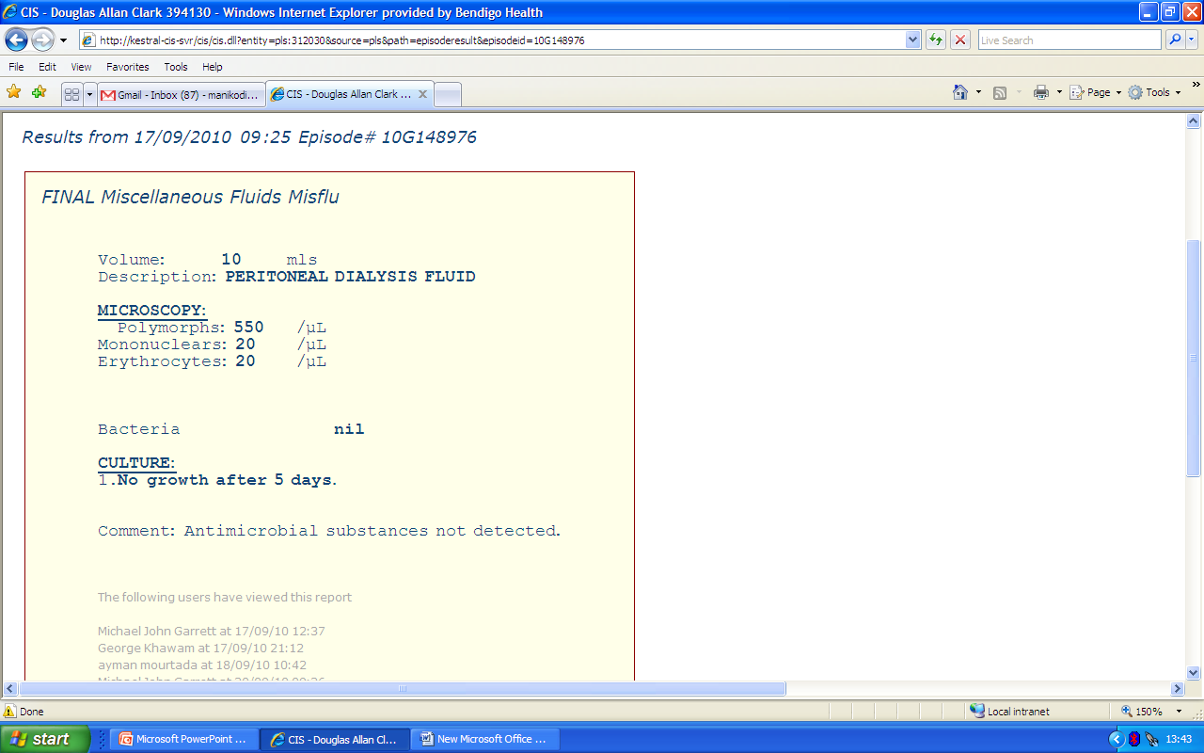

Slide 10
Diagnosis:
Peritonitis!
Commenced on intra peritoneal antibiotics
Discharged the next day with regular renal follow up

Slide 12
Peritoneal dialysis
Method of RRT for 170,000 patients worldwide
alternative to hemodialysis
Principles:
peritoneum = semipermeable dialysis membrane
through which fluid and solute move
effective peritoneal surface area is ~ 1.7-2.0 m2
ultrafiltration (removal of salt & water) enabled by
osmotic gradient generated by glucose or glucose
polymers

Slide 13
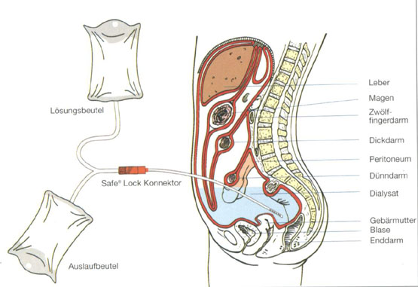

Slide 14
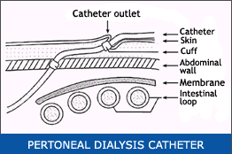

Slide 15
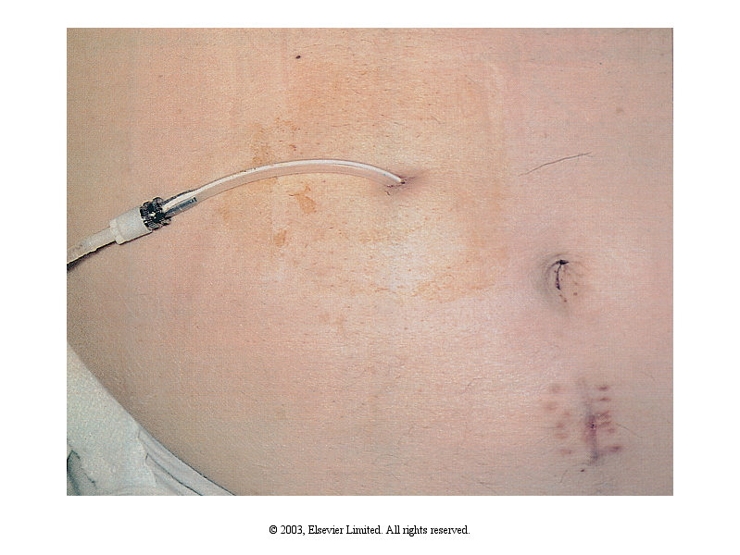

Slide 16
Types of peritoneal dialysis
Intermittent peritoneal dialysis
- was developed when HD was not readily available
for acute renal failure
Continuous ambulatory peritoneal dialysis
Automated peritoneal dialysis (APD)
- NIPD: nocturnal intermittent peritoneal dialysis
- CCPD: continuous cyclical peritoneal dialysis

Slide 17
Complications of PD
Infectious:
exit-site inflammation
peritonitis
Non-infectious:
hernias
hydrothorax
subcutaneous edema
Long term thickening of peritoneum which can be
serious but is not common

Slide 18
Peritonitis symptoms
Patients with peritonitis usually present with cloudy fluid or abdominal pain but may present with non specific abdominal symptoms including anorexia, diarrhoea etc or systemic symptoms
PD patient with any of these symptoms should be considered to have peritonitis unless proven otherwise

Slide 19
Abdominal pain
Fever
Nausea
Diarrhea
Abdominal tenderness
Rebound tenderness

Slide 20
Causes of peritonitis
Touch contamination – previously most common
Trans visceral migration due to intra abdominal pathology eg: diverticular disease - increasing
Catheter-related infection
Haematogenous
Vaginal source

Slide 21
Differentials
Constipation, Renal / Biliary colic, Peptic ulcer , Pancreatitis, Acute intestinal perforation .....etc
i.e.: causes of abdominal pain occurring in non dialysis population which can be investigated after peritonitis excluded rather than before.
PD patients who present to the hospital with pain abdomen should be considered to have peritonitis unless proven otherwise!!

Slide 22
General rule
PD Patients with early peritonitis may have no clinical signs such as peritonism or raised inflammatory markers.
These findings will eventually develop if management is inappropriately delayed.

Slide 23
Diagnosis
Urgent peritoneal dialysis sample needs to be collected & sent for urgent cell count with differential, gram stain, and culture
effluent cell count with white blood cells (WBC) more than 100/uL (after a dwell time of at least 2 hours), with at least 50% polymorphonuclear neutrophilic cells indicates peritonitis.

Slide 24
Differentials of a “cloudy bag”
Culture-positive infectious peritonitis
Infectious peritonitis with sterile cultures
Chemical peritonitis
Hemoperitoneum
Malignancy (rare)
Chylous effluent (rare)
Specimen taken from “dry” abdomen

Slide 25
Management of PD related peritonitis
After diagnosis
important to initiate appropriate antibiotic therapy
for PD-associated peritonitis as soon as possible.
The risk of relapse, catheter removal, permanent transfer to haemodialysis because of irreversible peritoneal membrane damage, and death are more likely to occur if treatment is not initiated promptly

Slide 26
Treatment
Empiric antibiotics are given IP & must cover both gram-positive and gram-negative organisms
Selection of empiric therapy- dependent on the local & patient history of sensitivities of organisms
Gram-positive organisms may be covered by vancomycin or a cephalosporin
Gram-negative organisms by a third generation
cephalosporin or amino glycoside

Slide 27
Antibiotic protocol at Bendigo
Cephazolin or vancomycin
and
Ceftazidime or gentamicin
Change antibiotics once sensitivities are back if appropriate - (MRSA will need Vancomycin)
Inappropriate AB’s may increase incidence of VRE
Routine treatment for a period of 2 -3 weeks depending on the organism.

Slide 28
Our concern
Treatment of PD related peritonitis is frequently delayed & often inappropriate
Our existing protocol is for renal registrar or consultant on call to be contacted immediately a patient arrives.

Slide 29
Why is time of the essence?
Delay in treatment of peritonitis causes irreversible thickening of the Peritoneal membrane & adhesions with reduced dialysis surface area. This may make PD ineffective.
Some patients have social reasons (eg distance travelled) or medical reasons (eg severe cardiac problems) meaning alternative haemodialysis may not be a difficult option.
Dialysis is a life supporting treatment.

Slide 30
Bendigo PD
100% of PD patients have a hard copy “alert” in their histories
Wording states “On peritoneal dialysis – contact renal team on presentation”
All PD patients have a yellow “Alert Card” – advised to present this to ED staff
Wording states “Peritoneal Dialysis Alert. On presentation to Emergency Department contact Renal Staff”. Reverse has contact details for Business and After Hours contact.
All patients have an alert activated on the ED IT system

Slide 31
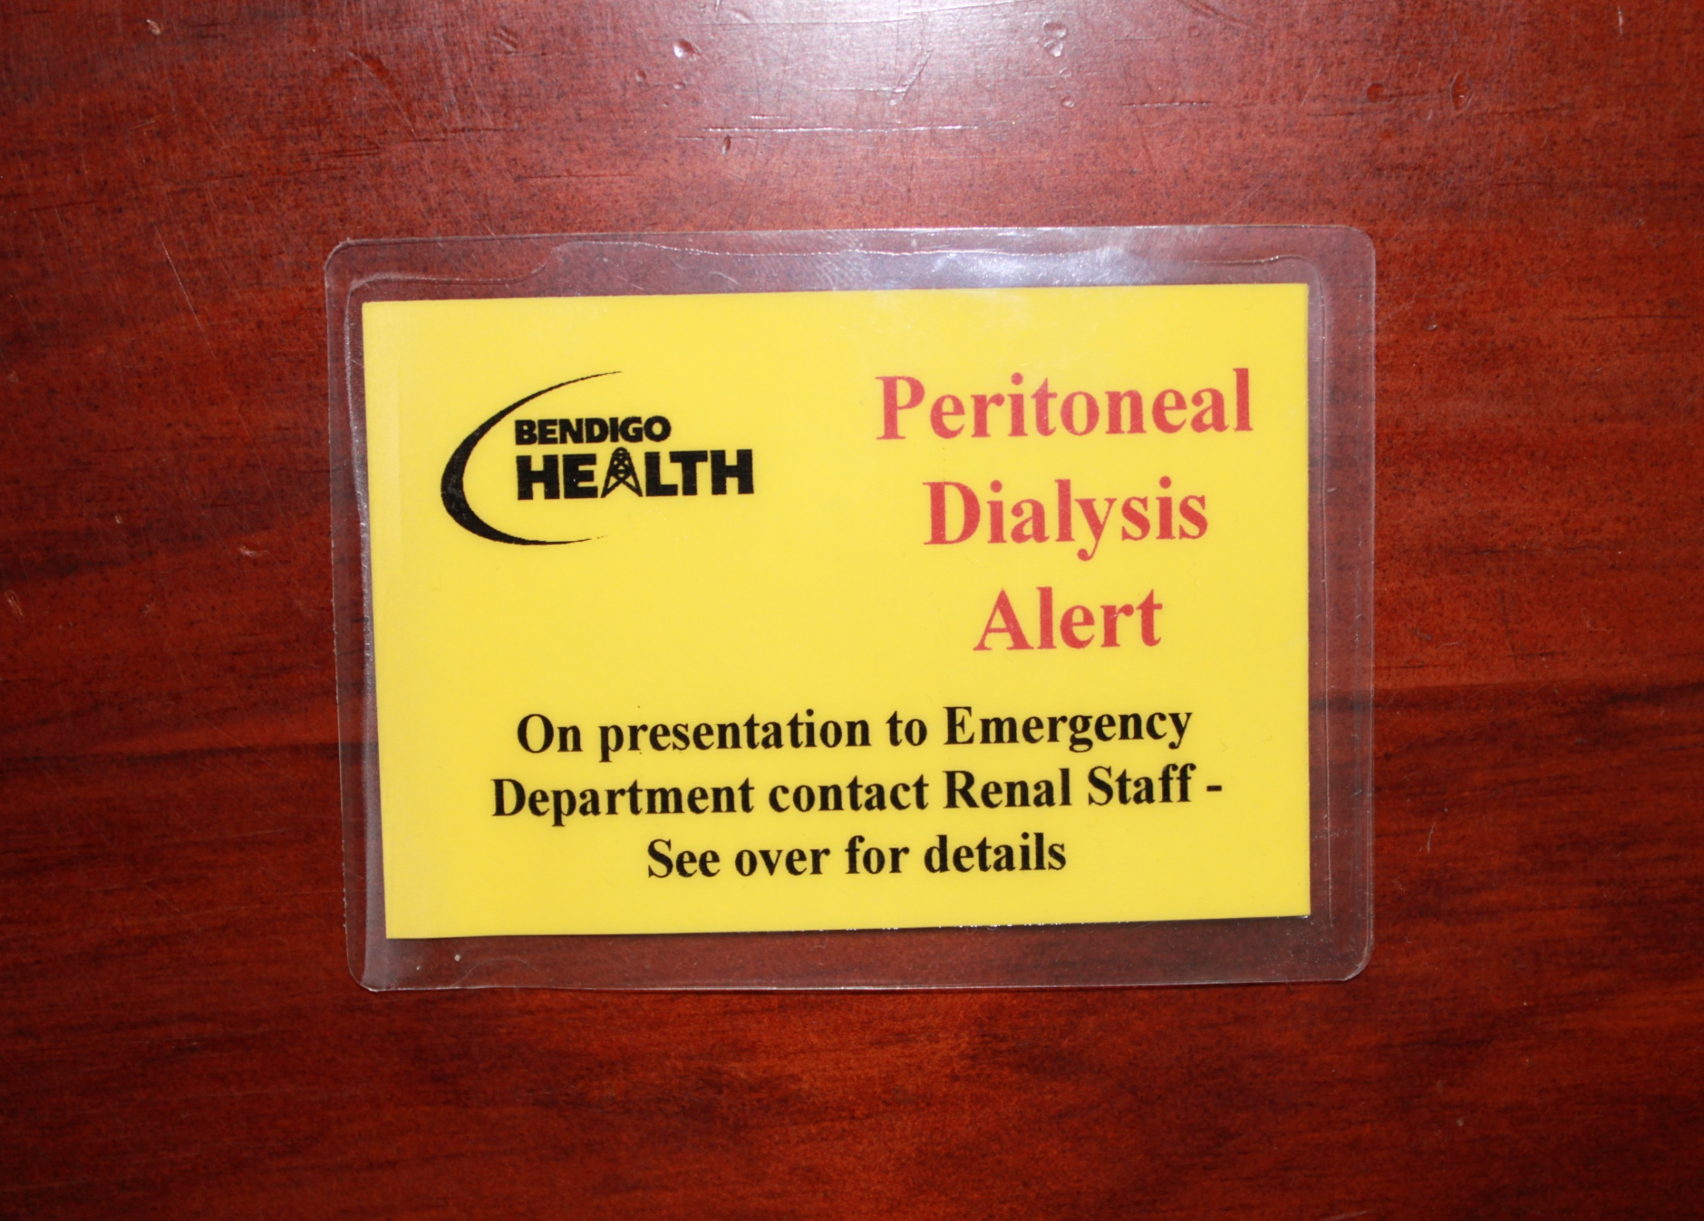

Slide 32
Bendigo PD
25 patients on PD roster
19 men and 6 women
Age ranges from 20yrs to 87rys (avg: 61.2)
Peritonitis rate at Bendigo: 1 episode/31 pt. months
(Accepted rate is 1episode/18 pt. months)
20.7% of cases were culture negative
Most common organism isolated was coagulase negative staph. epidermidis (17%)

Slide 33
Bendigo PD Peritonitis review
  delays in notification of Renal staff
  delays in commencing antibiotic therapy
Documentation review of all cases for the 12 month period
Assessed documents included
  ED notes
  Medication charts and orders
  Ward histories
  Alert notifications
  Pathology records

Slide 34
Data review
Data analysed for 12 month period (1 Dec 09 to 30 Nov 10)
23 presentations for PD related peritonitis affecting 13 individual patients
Data for 21 episodes of peritonitis analysed (one patient history not able to be located – logged on riskman; patient not deceased)
73% of presentations were Monday to Friday
76% of presentations during the hours of 0900 and 1730

Slide 35
Clinical presentation
11 (58%) patients presented with abdominal pain and cloudy PD effluent
3 abdominal pain
7 patients had varying combinations of abdominal pain, cloudy effluent, fever, nausea, vomiting diarrhoea

Slide 36
Notification to Renal staff
Data for 11 episodes of peritonitis available for analysis
  8 histories did not have time of notification documented
  2 patients had contacted the physician or PD staff directly
Time of notifying renal staff varied between 4 minutes and 426 minutes
(> 7 hours)
Average time of notification was 87 minutes

Slide 37
PD fluid sampling time
Data for 17 episodes of peritonitis available for analysis
  4 samples were brought in by patients
Time to procuring of PD fluid sample varied between 29 minutes and 531 minutes (> 8 hours)
Average time to collection of sample was 156 minutes (~2.5 hours)

Slide 38
First dose of antibiotics
Data for 19 episodes of peritonitis available for analysis
  1 chart did not have time of administration documented
  1 chart did not have administration of the antibiotics documented (not signed as having been administered)
Time to administration of antibiotics varied between 45 minutes and 631 minutes (> 10 hours)
Average time to administration of antibiotics was 237 minutes (~4 hours)

Slide 39
First dose of antibiotics
5 episodes of peritonitis reviewed where PD staff were available to assist ED with peritonitis management
  2 episodes patients had first antibiotics in less that one hour
  2 further episodes first antibiotics administered between 1 and 2 hours
  1 patient had a delay of ~ 7 hours in notifying renal staff. Antibiotics administered within 2 hours once notification occurred.

Slide 40
Our goals vs data
Treatment plan | Ideal | Bendigo base
Time taken to contact renal team | ASAP | 87mts
Time to procure DP fluid sample | Medical emergency: immediate | 156mts
Time to first dose of antibiotic | Less than one hour | 237mts

Slide 41
00:59 Hrs
Pt. Mr D.C Age: 63 Sex: M
Presentation to ED with -
Poor drainage of PD fluid
3hr history of mild pain abdomen
Generalised, not associated with
diarrhoea, vomiting, fever, chills,
or diaphoresis

Slide 42
Patient presented the ED staff with his alert card
Requested on multiple occasions for the renal team to be contacted overnight
- this did not occur

Slide 43
Some time after 3:57am
On examination:
Alert and oriented, not unwell looking
PR:90/mt BP: 128/70mmHg
RR:18/mt SPO2: 97% on room air
Afebrile
Chest/CVS: not mentioned in notes
Abdomen: soft, non tender with no mass
PD catheter site: not looking infected

Slide 44
9:25am
Diagnosis:
Peritonitis!
Commenced on intra peritoneal antibiotics at 10:10am
- 9 HRS post presentation
Discharged the next day with regular renal follow up

Slide 45
Causes of delayed treatment
Delay in notification of renal unit
Delay in sample collection esp. after HRS (med unit) - important that trained staff perform PD exchange
Delay in sample processing in lab (need to inform pathology of urgency)
Delay in deciding appropriate AB’s & their admin

Slide 46
Take home message
Peritoneal dialysis patients presenting to ED should be presumed to have peritonitis until proven otherwise
Important to initiate management with immediate consultation with renal unit.

Slide 47
THANK YOU

